Slide 1


DEPARTMENT BES-1
  Course: Data Structures using Python
Course code: 24sc1204
    Topic: SHELL SORT
Session-01

Slide 2



AIM OF THE SESSION
To familiarize students with the basic concept of Shell Sort
INSTRUCTIONAL OBJECTIVES
This Session is designed to:
Demonstrate Shell sort
Describe sorting technique work
List out the steps of the sorting algorithm
LEARNING OUTCOMES
At the end of this session, you should be able to:
Define Shell Sort
Describe algorithm and complexity of Shell Sort
Summarize Shell Sort

Slide 3
SESSION INTRODUCTION
The Shell Sort algorithm is an extension to the insertion sort method.
where it sorts subsets of elements that are distant from each other rather than adjacent. Here, an array is made h-sorted for a large value of h. The value of h is kept reducing until it becomes 1. If all sublists of every h’th element are sorted then the array is said to be h-sorted.

Slide 4
SESSION DESCRIPTION
Steps Involved in Shell sort-
Step 1 − Start
Step 2 − Initialize the value of gap size. Example: h
Step 3 − Divide the list into smaller sub-part. Each must have equal intervals to h
Step 4 − Sort these sub-lists using insertion sort
Step 5 – Repeat this step 2 until the list is sorted.
Step 6 – Print a sorted list.
Step 7 – Stop.

Slide 5

SESSION DESCRIPTION (Cont..)
Working of Shell Sort
Suppose, we need to sort the following array
We will use the original sequence of shell sort, i.e., N/2, N/4,....,1 as the intervals.
In the first loop, n is equal to 8 (size of the array), so the elements are lying at the interval of 4 (n/2 = 4). Elements will be compared and swapped if they are not in order.

Slide 6
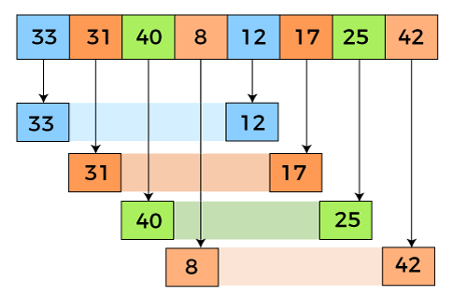
SESSION DESCRIPTION (Cont..)
Here, in the first loop, the element at the 0th position will be compared with the element at 4th position. If the 0th element is greater, it will be swapped with the element at 4th position. Otherwise, it remains the same. This process will continue for the remaining elements.
At the interval of 4, the sublists are {33, 12}, {31, 17}, {40, 25}, {8, 42}.

Slide 7

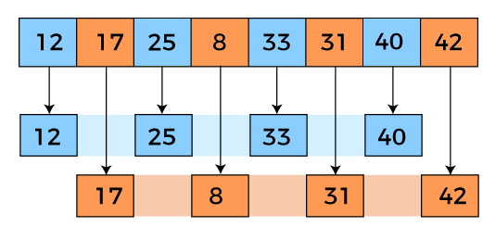
SESSION DESCRIPTION (Cont..)
Now, we have to compare the values in every sub-list. After comparing, we have to swap them if required in the original array. After comparing and swapping, the updated array will look as follows -
In the second loop, elements are lying at the interval of 2 (n/4 = 2), where n = 8.
Now, we are taking the interval of 2 to sort the rest of the array. With an interval of 2, two sublists will be generated - {12, 25, 33, 40}, and {17, 8, 31, 42}.

Slide 8

SESSION DESCRIPTION (Cont..)
Now, we again have to compare the values in every sub-list. After comparing, we have to swap them if required in the original array. After comparing and swapping, the updated array will look as follows -
In the third loop, elements are lying at the interval of 1 (n/8 = 1), where n = 8. At last, we use the interval of value 1 to sort the rest of the array elements. In this step, shell sort uses insertion sort to sort the array elements.

Slide 9
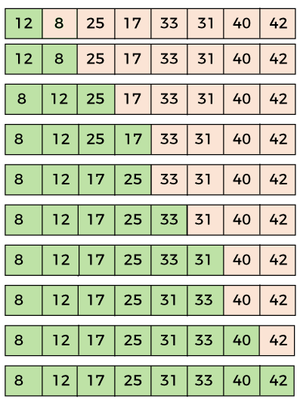
SESSION DESCRIPTION (Cont..)
Now, the array is sorted in ascending order.

Slide 10
SESSION DESCRIPTION (Cont..)
Shell Sort Algorithm Pseudocode
Procedure begin: Shell sort
Calculate gap size ($gap)
WHILE $gap is greater than 0
FOR each element of the list, that is $gap apart
Extract the current item
Locate the position to insert
Insert the item to the position
END FOR
Calculate gap size ($gap)
END WHILE
End procedure
Note: Initially the $gap is half of length of the array and the $gap size is recalculated by dividing the gap by 2 every time

Slide 11
SESSION DESCRIPTION (Cont..)
Shell Sort Implementation:
def shell_sort(arr):
gap = len(arr) // 2
while gap > 0:
for i in range(gap, len(arr)):
temp = arr[i]
j = i
while j >= gap and arr[j - gap] > temp:
arr[j] = arr[j - gap]
j -= gap
arr[j] = temp
gap //= 2
arr = [12, 34, 54, 2, 3]
shell_sort(arr)
print("Sorted array is:", arr)

Slide 12
SESSION DESCRIPTION (Cont..)
Complexity of Shell Sort Algorithm
Complexity in the Best Case: O(n*Log n)
Complexity in the Average Case: O(n*log n)
Complexity in the Worst-Case Scenario: O (n2)

Slide 13
ACTIVITIES/ CASE STUDIES/ IMPORTANT FACTS RELATED TO THE SESSION
Since Shell sort can be implemented using little code and does not use the call stack, some implementations of the qsort function in the C standard library targeted at embedded systems use it instead of quicksort. Shell sort is, for example, used in the uClibc library. For similar reasons, an implementation of Shell sort is present in the Linux kernel.
Shell sort can also serve as a sub-algorithm of introspective sort, to sort short subarrays and to prevent a slowdown when the recursion depth exceeds a given limit. This principle is employed, for instance, in the bzip2 compressor.

Slide 14
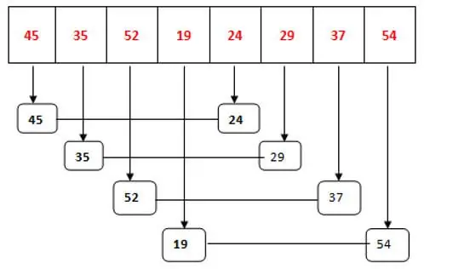
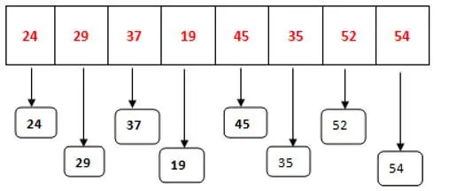


EXAMPLES

Slide 15
SUMMARY
Shell Sort is mainly a variation of Insertion Sort. In insertion sort, we move elements only one position ahead. When an element has to be moved far ahead, many movements are involved. The idea of Shell Sort is to allow the exchange of far items. In Shell sort, we make the array h-sorted for a large value of h. We keep reducing the value of h until it becomes 1. An array is said to be h-sorted if all sublists of every h^{th} element are sorted.

Slide 16
SELF-ASSESSMENT QUESTIONS
Who invented the shell sort algorithm?
a) John Von Neumann
b) Donald Shell
c) Tony Hoare
d) Alan Shell
The worst case running time of shell sort, using Shell’s increments is?
O(N)
O(N log N)
O(log N)
O(N²)

Slide 17
TERMINAL QUESTIONS
1. Describe what is Shell sort
2. List out steps involved in Shell sort
3. Analyze time complexity of Shell sort
4. Summarize the working principle of Shell sort

Slide 18
REFERENCES FOR FURTHER LEARNING OF THE SESSION
Reference Books:
Sites and Web links:
  https://docs.python.org/3/tutorial/datastructures.html
  https://www.w3schools.com/dsa/dsa_intro.php
  https://www.geeksforgeeks.org/python-data-structures/
  https://onlinecourses.nptel.ac.in/noc25_cs59/preview
  https://www.coursera.org/learn/python-data
  https://www.codecademy.com/learn/learn-data-structures-and-algorithms-with-python
Data Structures and Algorithm Analysis in PYTHON, 2010, Mark Allen Weiss, Second Edition, Pearson Education.
Data Structures and Algorithms, A.V.Aho, J.E.Hopcroft, and J.D.Ullman, Pearson Education, First Edition Reprint2003.
Advanced Guide to Python 3 Programming, John Hunt, 4th Edition, Springer Nature Switzerland AG 2019.
Python Basics: A Practice Introduction to Python 3, David Amos, Dan Bader, Joanna Jablonski, Fletcher Heisler, 4th edition, Real Python.

Slide 19
THANK YOU
Team – Data Structures using Python

